Slide 1
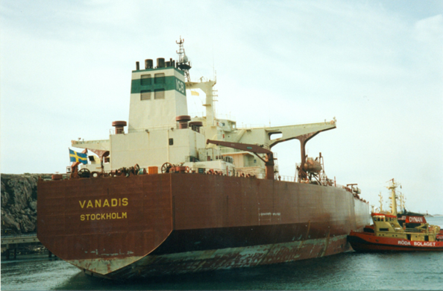
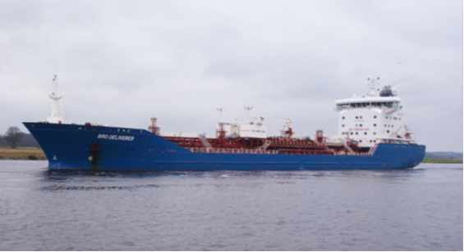
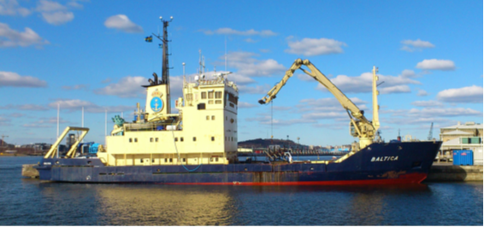
Malin Liljenborg
M/T Vanadis 327x57m
M/T Bro Deliverer 146x22m
M/V Baltica 54x12m

Slide 2
Additional Nautical Information
The importance of
Malin Liljenborg

Slide 3
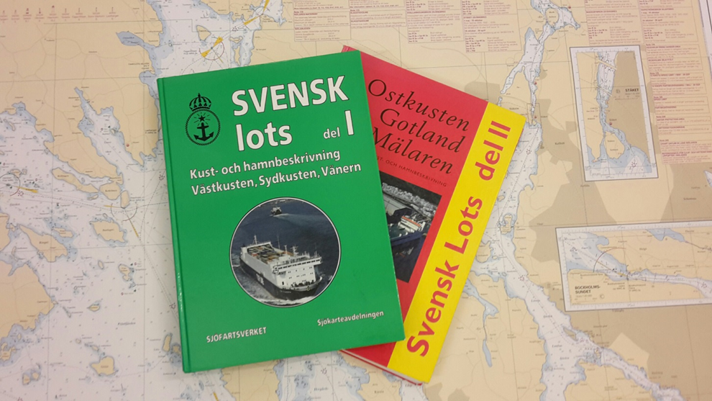
The past…..

Slide 4
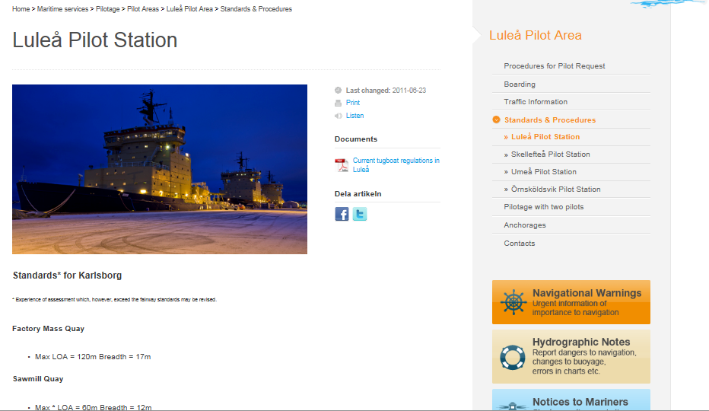
... the present…

Slide 5
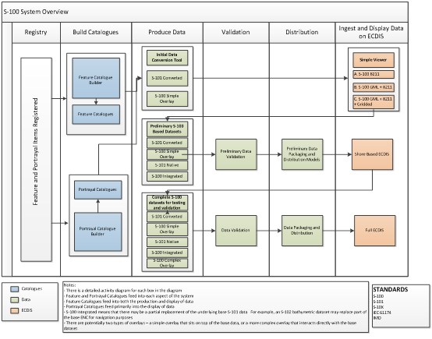
… the future

Slide 6
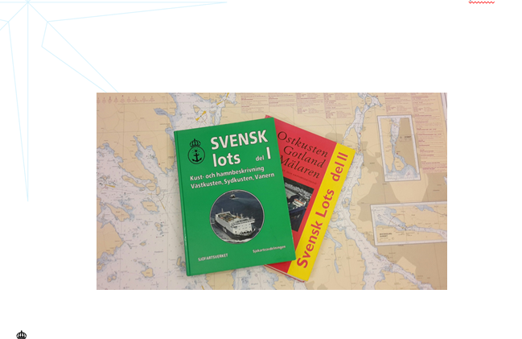
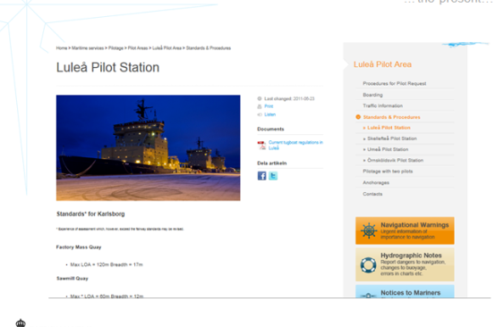
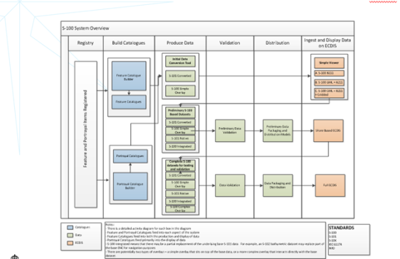
How long before the ”future” is here???
The past…
…the present…
…the future
How can we improve the present…
…and shorten the time until the future???

Slide 7
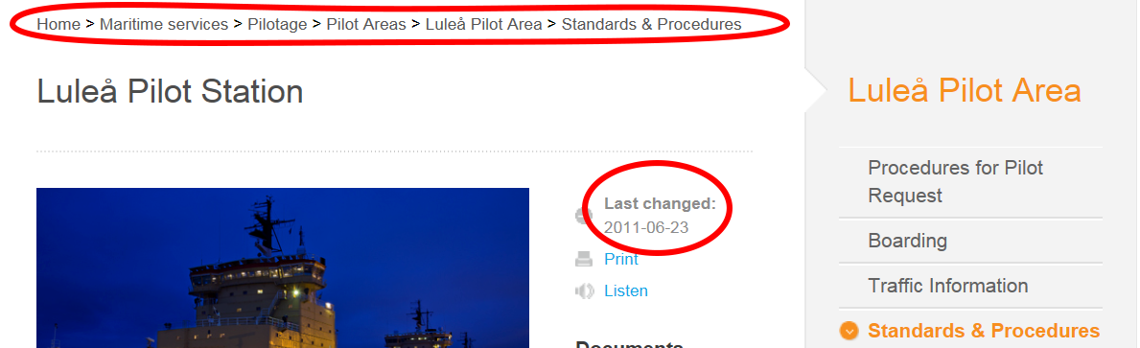
…the present..

Slide 8
Can NIPWG give guidelines to HO on how to produce digital NP information in the near future?

Slide 9
Sweden´s way forward
What information does the end-user need?
How can we as a HO distribute the information in a modern way?
How will the end-user now that the information is accurate and up-to-date?
How can we make our new system ready to meet future demands?

Slide 10
Thank you!

